Slide 1
TELECOM CUSTOMER CHURN PREDICTION
1

Slide 2

Agenda
About the Data: Introduction to a dataset that has been used for the project.
Insights to find: What are the objectives & insights that are to be found out?
Steps for EDA & Cleaning Data: Various steps are used are used for data cleaning & EDA process.
Visual Analytics: Different visuals & summaries to understand data well.
Key Findings: Insights we find out according to various questions.
2

Slide 3

About Dataset
Each row represents a customer and each column contains the customer attributes described in the column metadata.
The Dataset shows the customer’s account details like customer id, gender, senior citizen, partner and whether dependent on someone or not.
It shows various services that each customer has signed up like phone services, tenure, Multiple lines, internet service, online security & backup, device protection streaming TV & movies and then support.
It also shows customer account information like a contract, payment method, paperless billing, monthly charges and total charges.
Customer who left this column is called Churn.

Slide 4


About Project
The telecom company provides telecom services to many clients. But due to many reasons. customers switch from one service provider to other. Telecom churn has emerged as the single largest cause of revenue erosion for telecom operators.
Now telecom company manager wants to know actionable insights to retain customers and increase customers’ lifetime values.
Here in this project we have to analyse a huge dataset from which we are going to extract actionable insights & make a analysis that can be useful for a Sales manager to work on and see how our business is doing. Also, he can make data-driven decisions & which will help him to retain customers and increase customers’ lifetime values.
We have extracted many different insights which we will see further in this report.

Slide 5
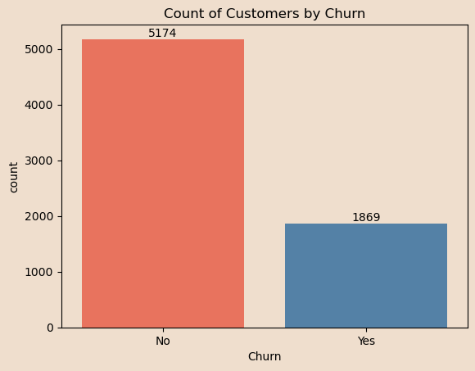

Count of Customers by Churn
The count plot reveals a clear disparity between churned and non-churned customers. Non-churned customers significantly outnumber churned ones, indicating strong retention. However, the 26.54% churn rate is still concerning, signaling the need to identify and address key churn drivers to further reduce the churn rate.
5

Slide 6

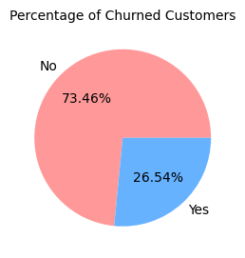
Percentage of Churned Customers
The pie chart shows that 26.54% of our customers have churned. While most customers are retained, the churn rate is high enough to warrant focused retention efforts. Strategies should be designed to address issues causing churn and reduce this percentage further.

Slide 7


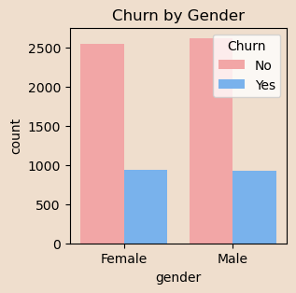
Churn by Gender
There is no significant difference in churn rates between male and female customers, suggesting that churn factors are not gender-specific. Therefore, gender-focused retention efforts may not be necessary, and more attention should be placed on customer behavior and usage patterns.
7

Slide 8

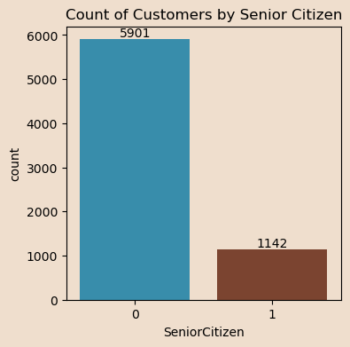
Count of Customers by Senior Citizen
The plot displays a clear difference in customer counts between senior and non-senior citizens. There are 1,142 senior customers and 5,901 non-senior customers, highlighting a higher prevalence of non-senior customers in the dataset.

Slide 9

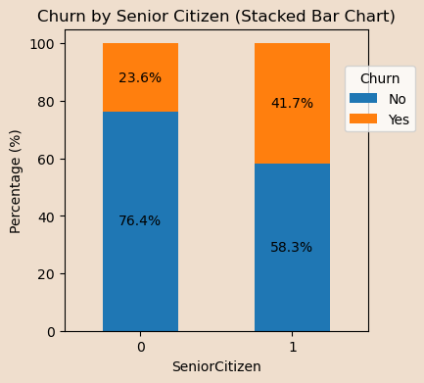
Churn by Senior Citizen
Senior citizens have a higher churn rate compared to non-senior customers. This indicates a potential area for targeted retention efforts, such as senior-focused loyalty programs or tailored services to better meet their needs.
9

Slide 10
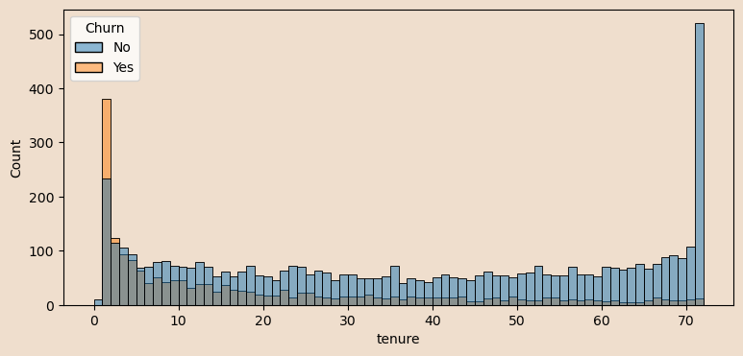

Churn Analysis by Customer Tenure
Customers with less than one year of tenure are the most likely to churn, with a churn rate of 50%. As tenure increases, the churn rate decreases, with customers of 3+ years having only a 15% churn rate. Retention efforts should prioritize new customers during their first year, as this is the critical period for churn.

Slide 11

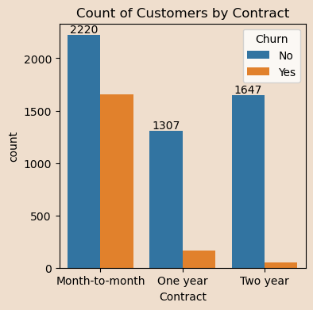
Count of by Customers by Contract
Customers on month-to-month contracts show the highest churn rate at 42%, while those on longer contracts have much lower churn rates (11% for one-year contracts and 3% for two-year contracts). This suggests that promoting longer-term contracts, possibly through incentives, can help reduce churn significantly.
11

Slide 12
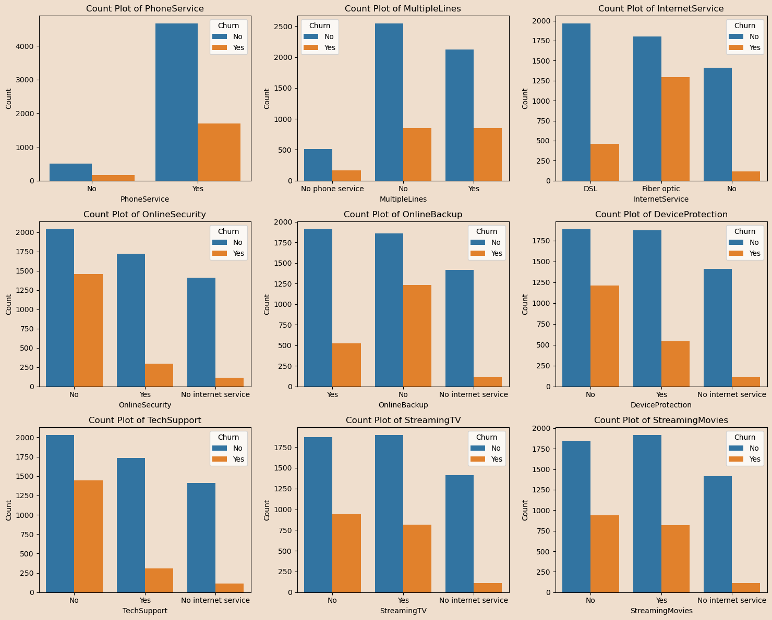
Distribution of Customer Services and Churn Analysis

Slide 13
Distribution of Customer Services and Churn Analysis
The analysis shows that certain services are associated with lower churn rates. Customers who use services such as online security, tech support, and device protection are less likely to churn, indicating that these services add value and enhance customer satisfaction. On the contrary, customers without these services have higher churn rates. Encouraging the adoption of these services, either through targeted offers or highlighting their benefits, could significantly improve customer retention.

Slide 14
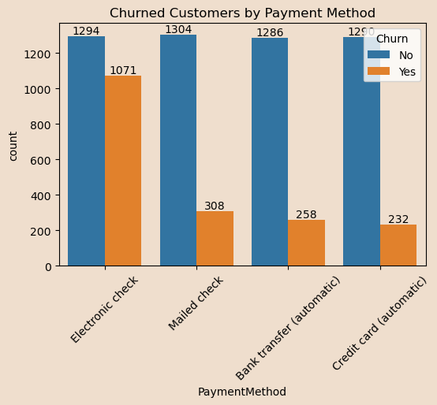

Churned customers by Payment Method
Customers using electronic checks have a significantly higher churn rate compared to those using bank transfer, credit card, or mailed checks. To reduce churn, a targeted strategy could involve encouraging electronic check users to switch to more reliable payment methods, potentially through incentives or addressing any dissatisfaction with the service.

Slide 15

Recommendations:
Promote Long-Term Contracts: Offer discounts or perks for switching from month-to-month to long-term contracts.
Encourage Payment Method Switch: Target electronic check users with offers to switch to more reliable methods like credit cards or bank transfers.
Engage Early Tenure Customers: Focus on loyalty programs or personalized support for customers in their first year.
Senior Citizen Retention: Offer tailored discounts or support to reduce churn among senior customers.
Promote Key Services: Increase adoption of online security, tech support, and device protection to lower churn.

Slide 16

Thank you
This presentation prepared by Deepika Pal
A Data Analyst specializing in Python and visualization
16
deepikpal123@gmail.com

